Slide 1
Peak_Parser.py The Wombats: Nick, Ying, Sabriya, and Dimitri
Notes:
1
Title of my talk
My project will focus on the study of a cell population that resides in the gut

Slide 2
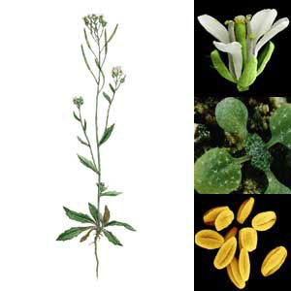
What is the difference in DNA binding between two Arabidopsis transcription factors?
Arabidopsis thaliana
Transcription factors
ABF2: bZip transcription factor that binds to (ABA) responsive element (ABRE) to activate abscisic acid responsive genes
and
TGA5: bZip transcription factor that binds to OCS-element to activate salicylic acid responsive genes
https://jow39.wordpress.com/2014/03/24/arabidopsis-thaliana/
Notes:
2
Title of my talk
My project will focus on the study of a cell population that resides in the gut

Slide 3
Our analysis can be applied to any high- throughput assay that profiles transcription factor binding sites
ChIP-Seq: Chromatin immunoprecipitation and sequencing
DAP-Seq: DNA Affinity purification and sequencing

Slide 4
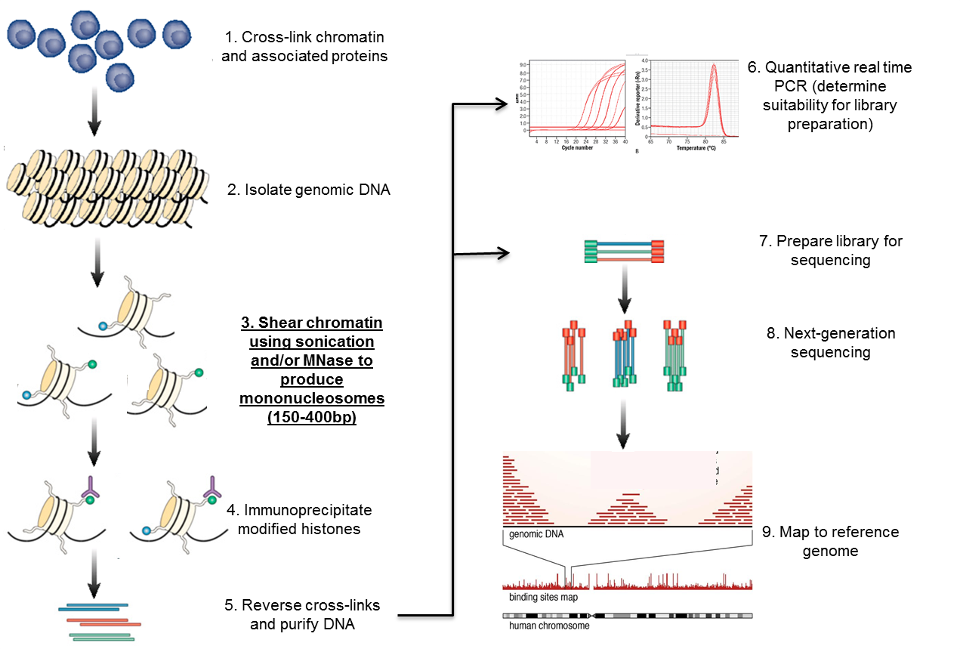
ChIP-Seq to investigate chromatin occupancy …But this assay is difficult for non-model species

Slide 5
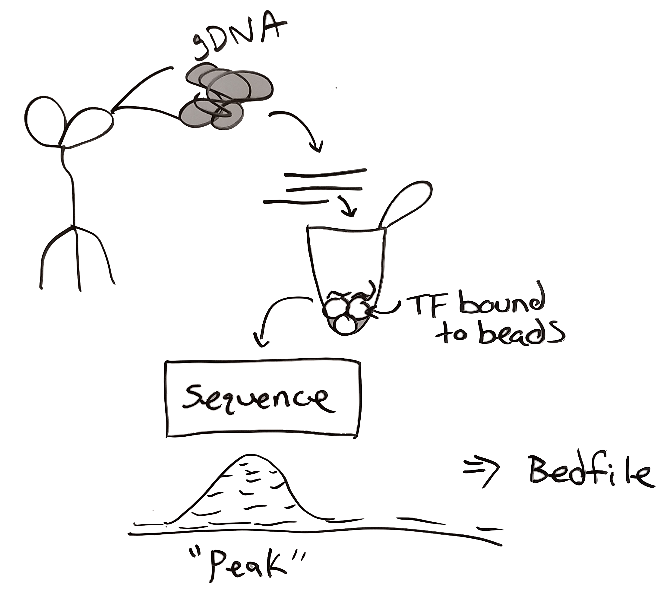
DAP-Seq is an assay to profile transcription factor binding sites in vito

Slide 6
PROJECT Questions
Within 1kb upstream of gene = “promoter”
What genes are associated with ABF2 and TGA5 binding sites?
How many peaks are being bound by ABF2 and TGA5?
What peaks contain a TF specific motif?
How can we use this refined gene list for downstream transcription analysis?

Slide 7
PROJECT GOALS
Parse through input files
Bed file
GFF file
Fasta file
Bedtools (intersect)
Bedtools (fastafrombed)
Biopython (bio.seq) (motif caller)
Obtain gene list
to validate experimentally
Expression files from
RNA-Seq data
Notes:
7
Title of my talk
My project will focus on the study of a cell population that resides in the gut

Slide 8
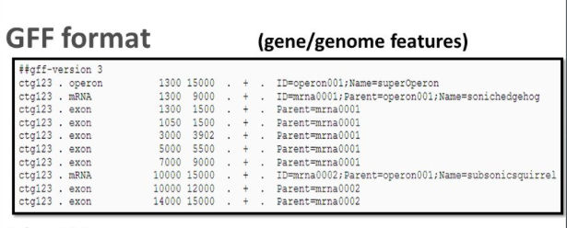
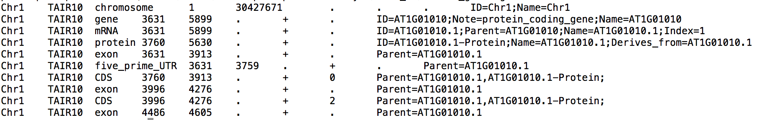
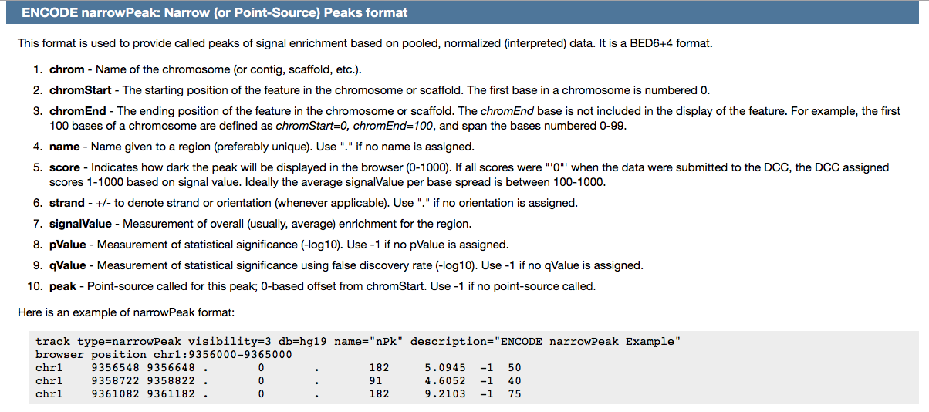
Part 1: Peak_Parser.py file format
GFF file holds gene model information for the genome
Bedfiles hold peak position information for each experiment

Slide 9
Part 1: Peak_Parser.py two ways to Parse data files
Option 1: Creating new classes
peakparser.py
Option 2: Panda Python Package and Unix
gff_parser.py

Slide 10
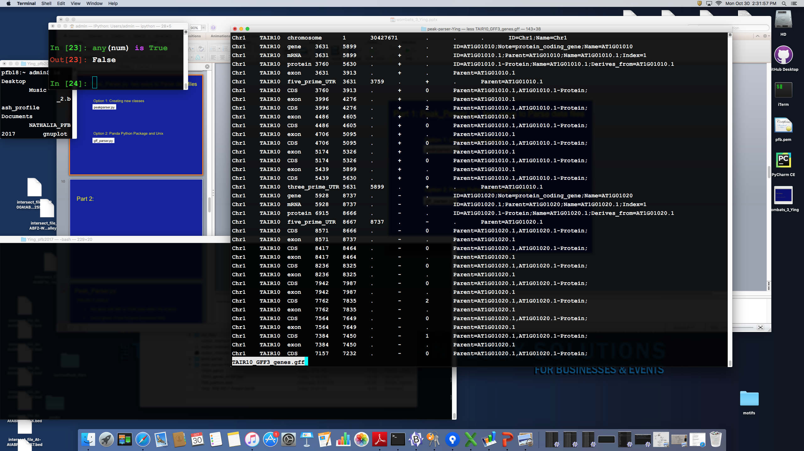
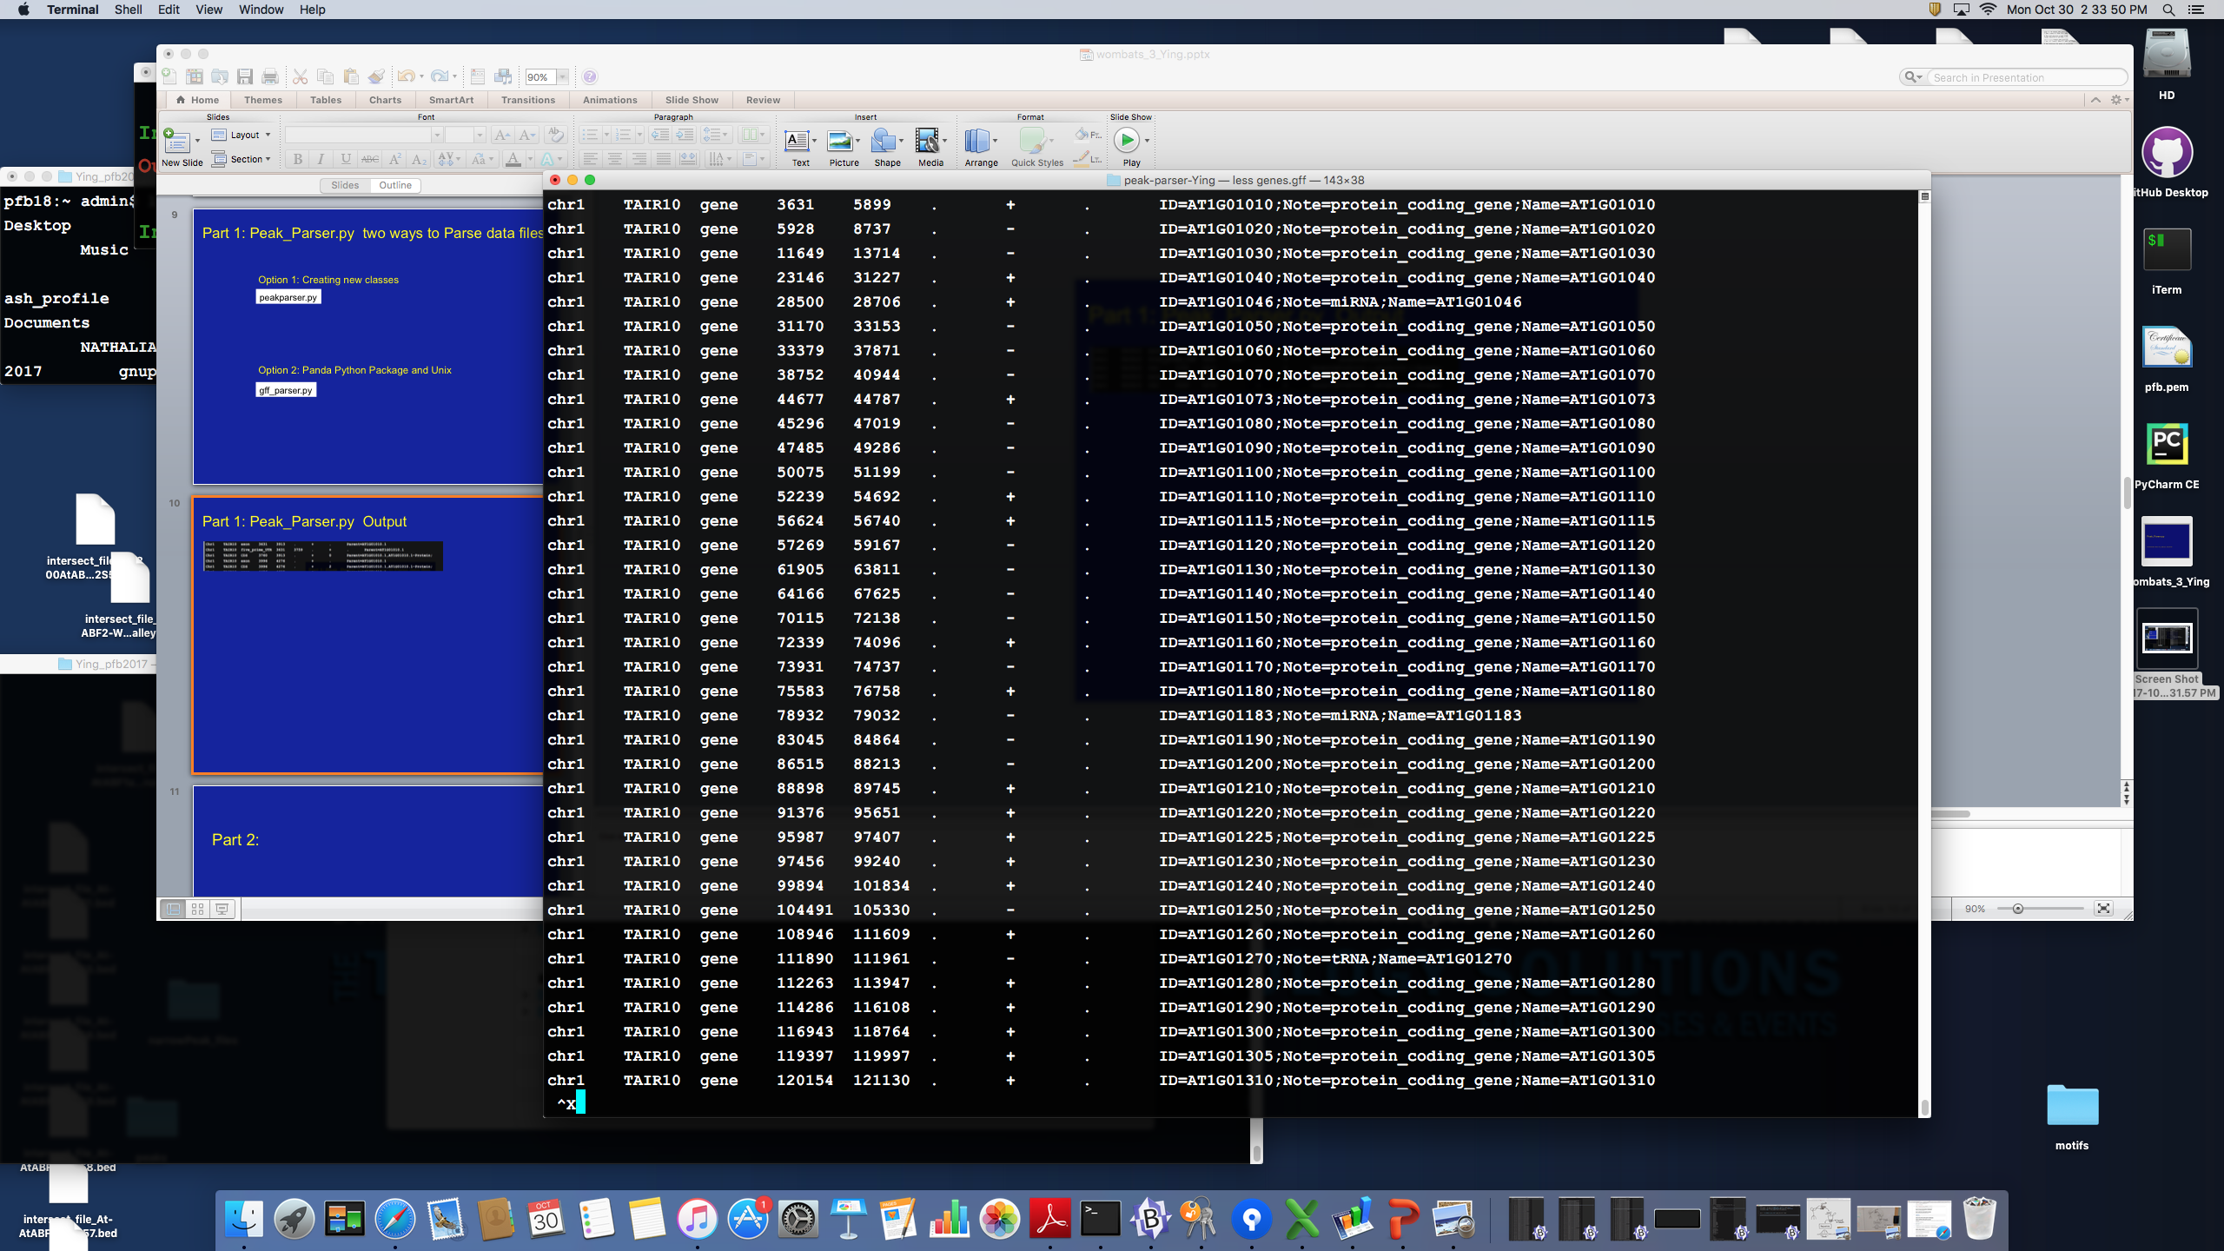
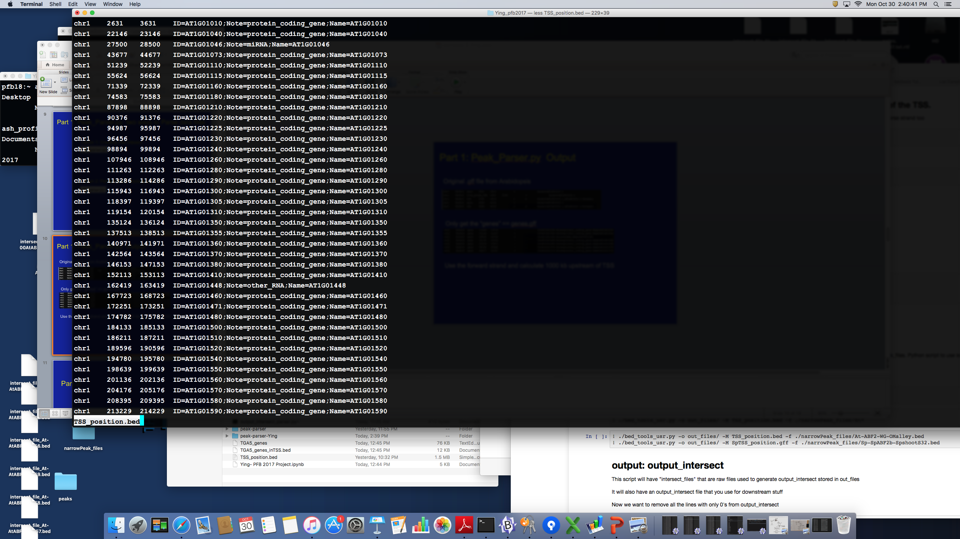
Part 1: Peak_Parser.py Output
Original .gff file from Arabidopsis
Only get the “genes” == genes.gff
Use the forward and reverse strand and calculate 1000 kb upstream of TSS

Slide 11
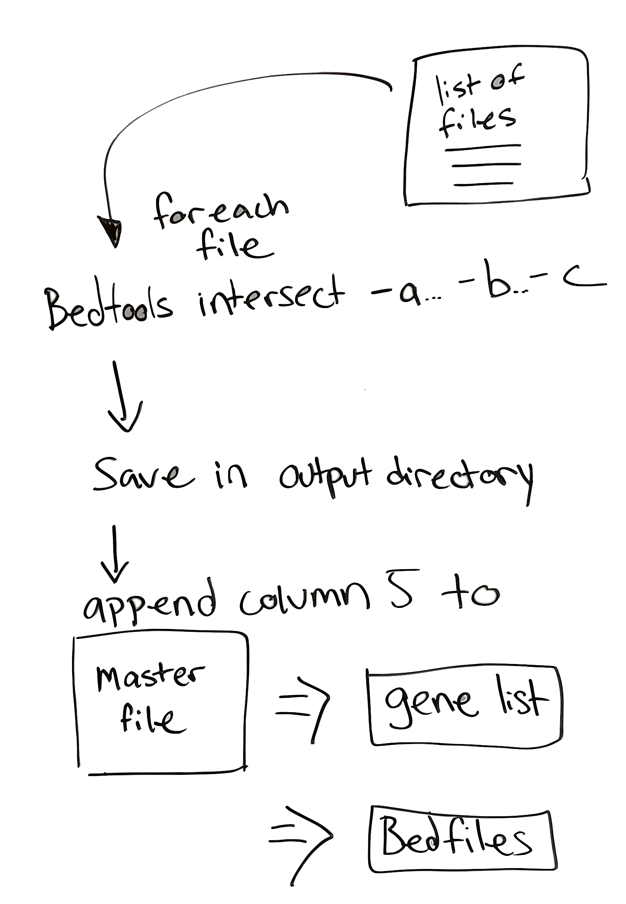
Part 2: Count number of peaks using BedTools
bed_tools_usr.py

Slide 12
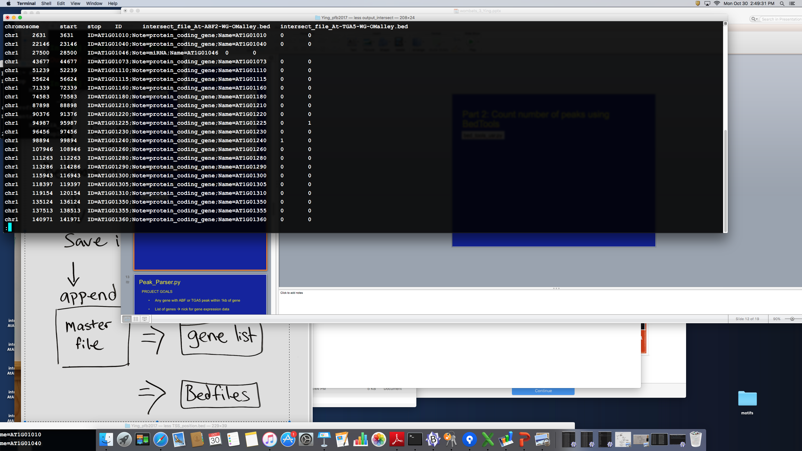
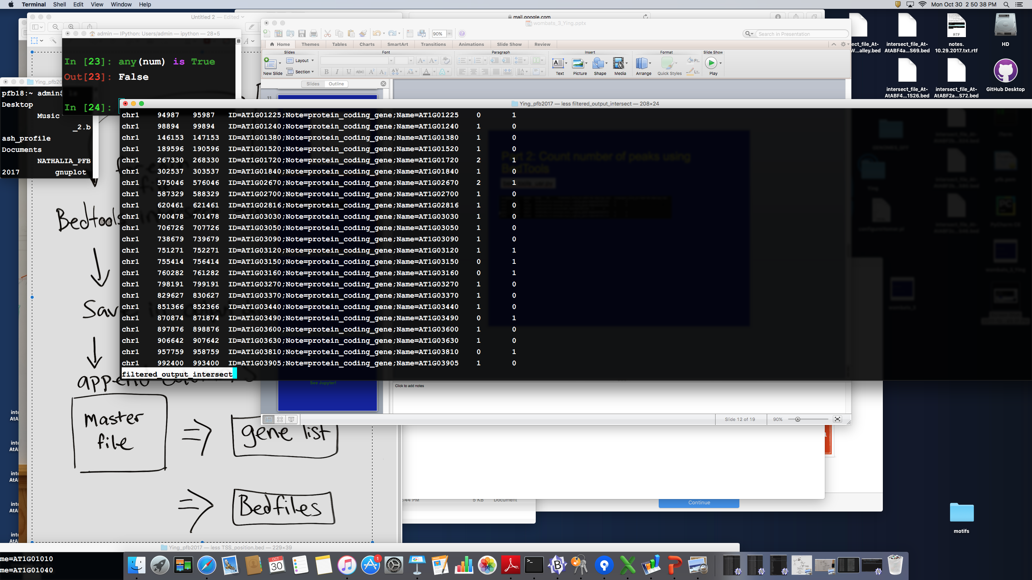
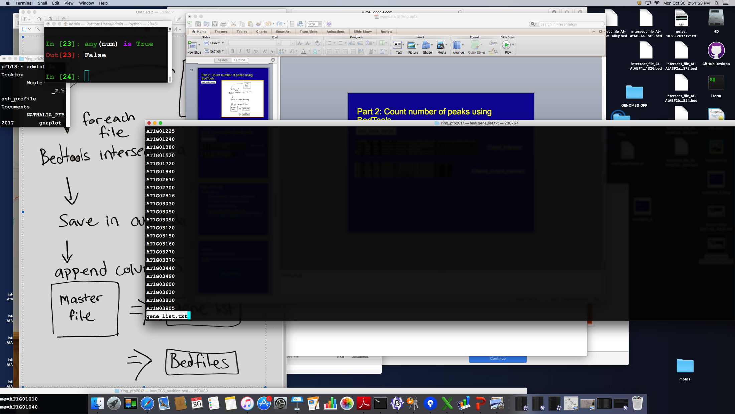
Part 2: Count number of peaks using BedTools
bed_tools_usr.py
Output_intersect
Filtered_Output_intersect
Genelist

Slide 13
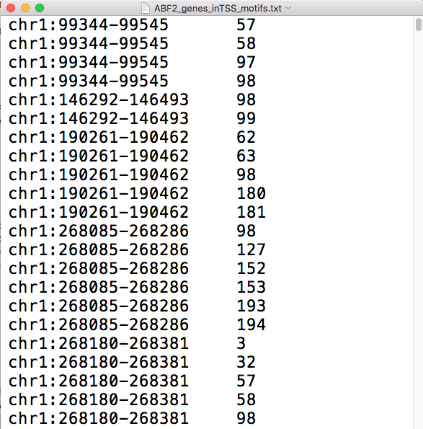
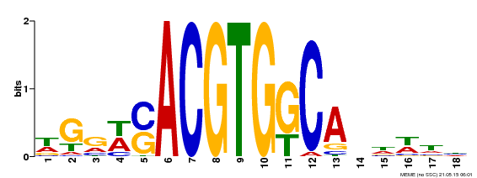
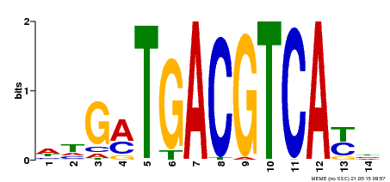
Part 3: Do the peaks in the promoter contain the motif?
Input:
Genome in fasta format
Bedfile from part 1
Motif_search.py
Fasta file containing sequence for all Bedfile coordinates
Peak Coordinates
Position of Motif Instance
ABF2
Motif Search
TGA5

Slide 14
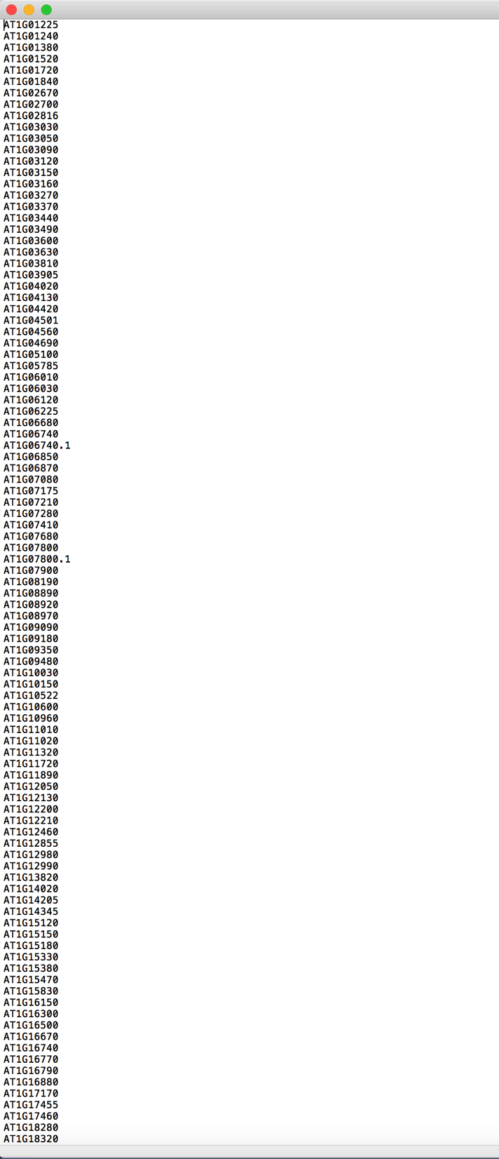
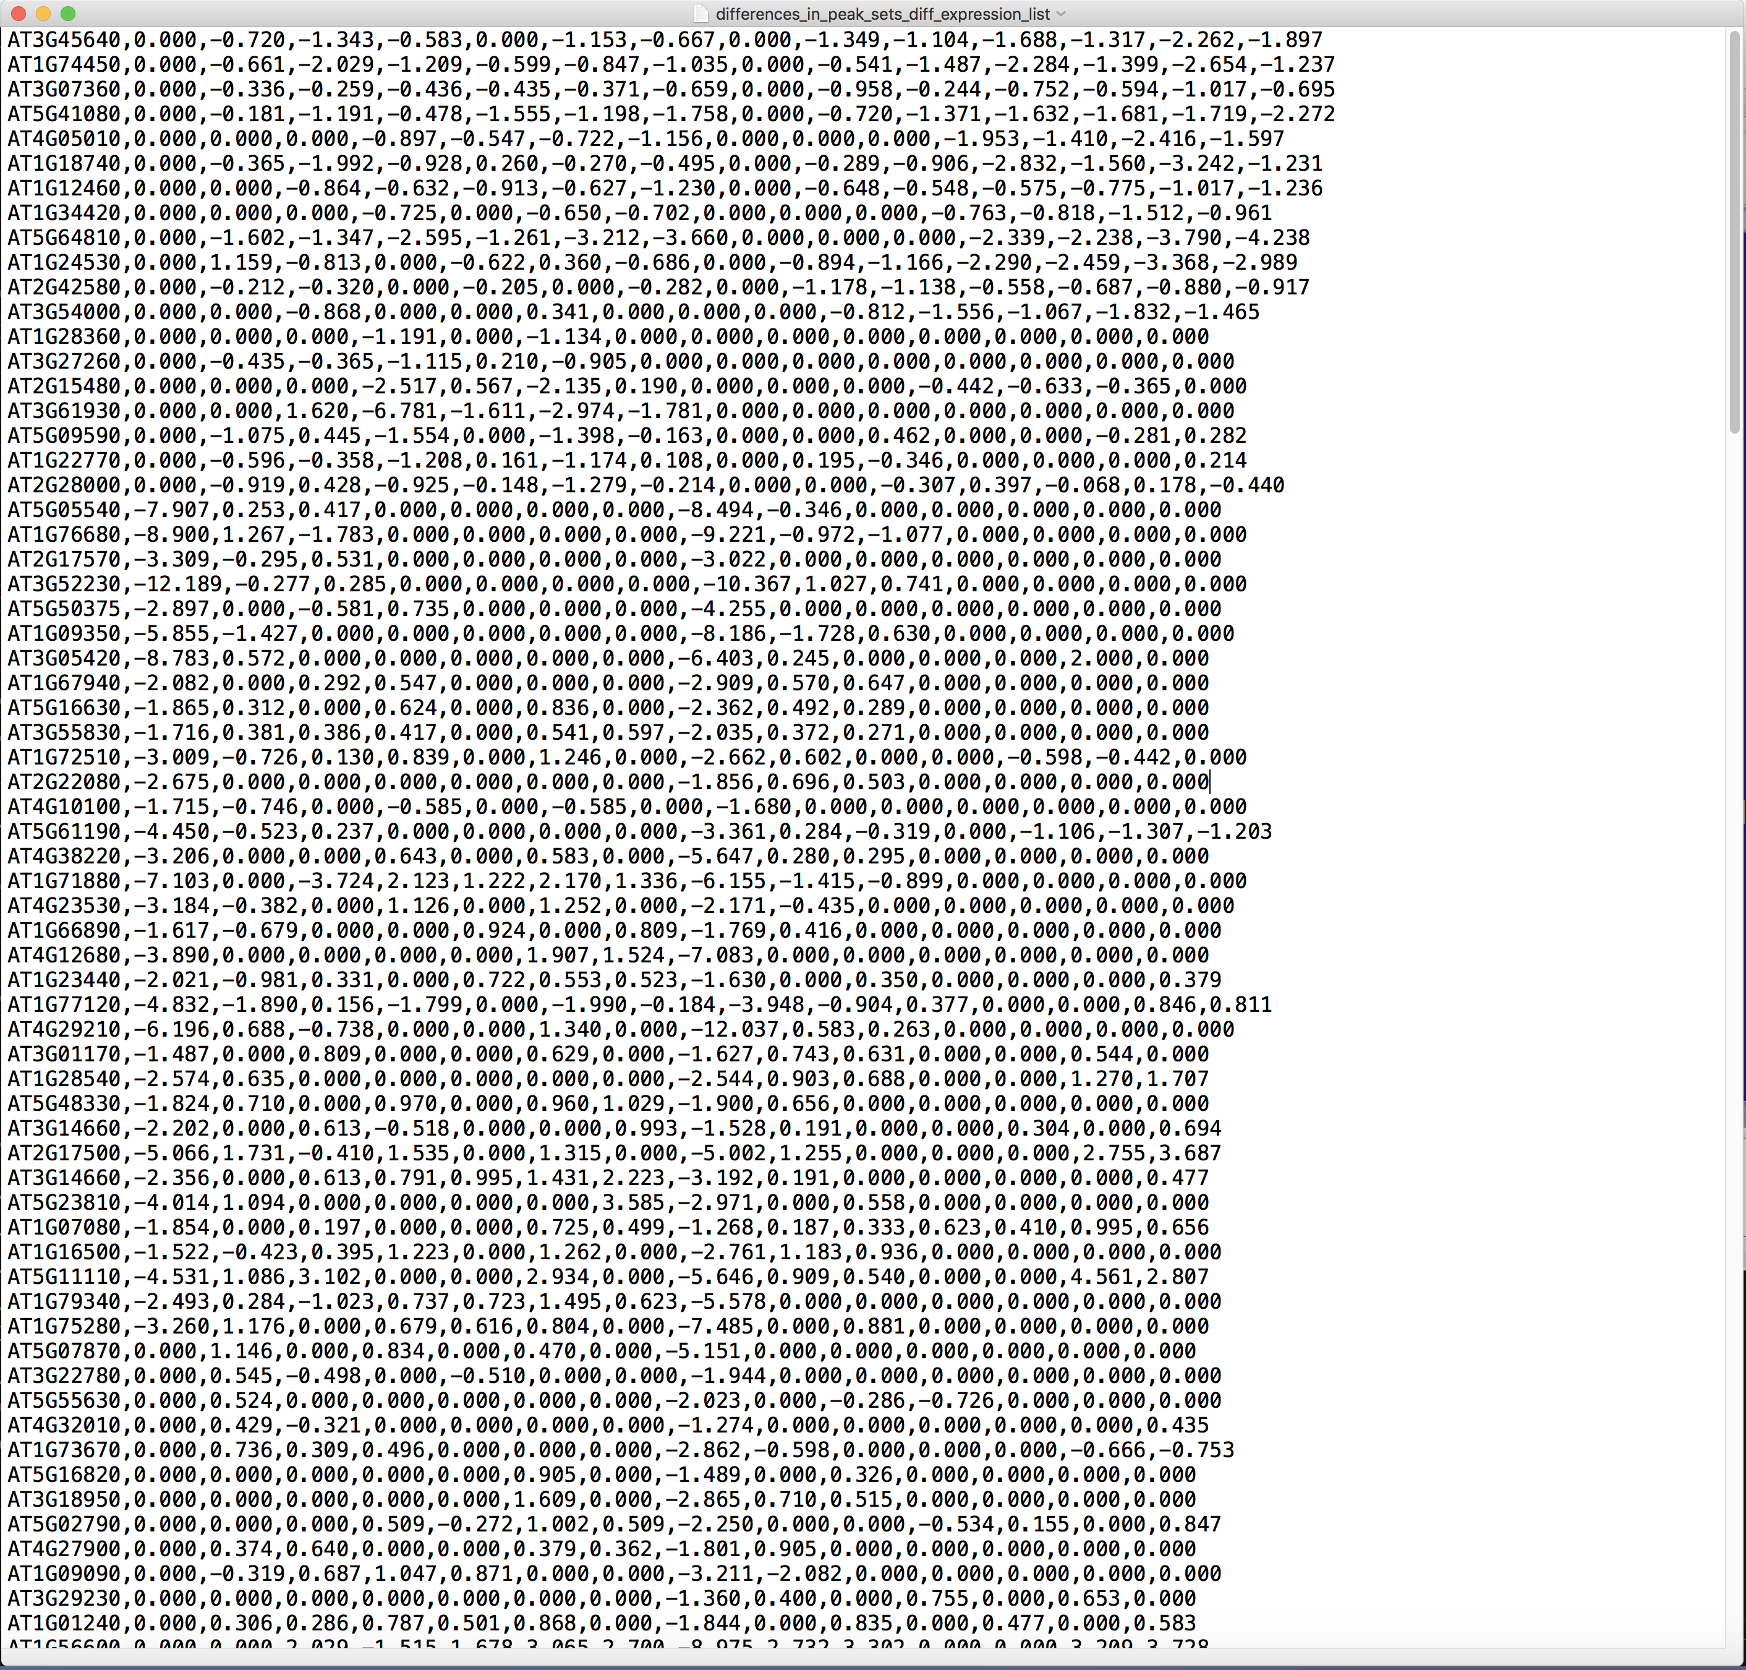
Part 4: Could we associate the presence of these peaks with gene expression?
Input:
Gene list & DESeq Expression file
Output:
Log2 Fold-change
Expression
Motif_search.py
Bedfile_parser.py

Slide 15
Summary
Original bed file: > 2000 peaks
Promoter:
500-900 peaks
Filter by motif presence:
449-813 peaks
Filter by RNA-Seq
~230 genes
We identified expression patterns for 230 genes regulated by the presence of ABF2 or TGA5 in the gene promoter.

Slide 16
Applications
Using GFF file to annotate the bed files
Extract nucleotide sequence from 2 positions
.
Compare control vs. Treatment groups
Compare distance, width, and peak intensity
Notes:
16
Title of my talk
My project will focus on the study of a cell population that resides in the gut

